Slide 1
File Management
cs431-cotter

Slide 2
Fig 13-2: The External View of the File Manager
Application
Program
mount()
write()
WriteFile()
open()
CreateFile()
close()
CloseHandle()
ReadFile()
lseek()
read()
SetFilePointer()
File Mgr
Memory Mgr
Device Mgr
Device Mgr
File Mgr
Memory Mgr
Process Mgr
Process Mgr
UNIX
Windows
Hardware
Operating Systems: A Modern Perspective, Chapter 13

Slide 3
File Management
File is a named, ordered collection of information
The file manager administers the collection by:
  Storing the information on a device
  Mapping the block storage to a logical view
  Allocating/deallocating storage
  Providing file directories
What abstraction should be presented to programmer?
Operating Systems: A Modern Perspective, Chapter 13

Slide 4
More Abstract Files
Inverted files
  System index for each datum in the file
Databases
  More elaborate indexing mechanism
  DDL & DML
Multimedia storage
  Records contain radically different types
  Access methods must be general
Operating Systems: A Modern Perspective, Chapter 13

Slide 5
Why Programmers Need Files
<head>
…
</head>
<body>
…
</body>
HTML
Editor
Web
Browser
File
Manager
foo.html
File
Manager
<head>
…
</head>
<body>
…
</body>
Structured information
Can be read by any applic
  Accessibility
  Protocol
Persistent storage
Shared device
Operating Systems: A Modern Perspective, Chapter 13

Slide 6
Implementing Low Level Files
Secondary storage device contains:
  Volume directory (sometimes a root directory for a file system)
  External file descriptor for each file
  The file contents
Manages blocks
  Assigns blocks to files (descriptor keeps track)
  Keeps track of available blocks
Operating Systems: A Modern Perspective, Chapter 13

Slide 7
File Systems
Essential requirements for long-term information storage:
It must be possible to store a very large amount of information.
The information must survive the termination of the process using it.
Multiple processes must be able to access the information concurrently.
Tanenbaum, Modern Operating Systems 3 e, (c) 2008 Prentice-Hall, Inc. All rights reserved. 0-13-6006639
cs431-cotter
Notes:
cs431-cottercs431-cotter

Slide 8
File Systems
Think of a disk as a linear sequence of fixed-size blocks and supporting reading and writing of blocks. Questions that quickly arise:
How do you find information?
How do you keep one user from reading another’s data?
How do you know which blocks are free?
cs431-cotter
Tanenbaum, Modern Operating Systems 3 e, (c) 2008 Prentice-Hall, Inc. All rights reserved. 0-13-6006639
Notes:
cs431-cottercs431-cotter

Slide 9
Disk Organization
Boot Sector
Volume Directory
Blk₀
Blk₁
…
Blk_{k-1}
Track 0, Cylinder 0
…
Blk_{k}
Blk_{k+1}
Blk_{2k-1}
Track 0, Cylinder 1
…
Blk
Blk
…
Blk
Track 1, Cylinder 0
…
Blk
Blk
…
Blk
Track N-1, Cylinder 0
…
Blk
Blk
…
Blk
Track N-1, Cylinder M-1
Operating Systems: A Modern Perspective, Chapter 13

Slide 10
Low-level File System Architecture
Block 0
b₀ b₁ b₂ b₃
…
…
b_{n-1}
.
.
.
Sequential Device
Randomly Accessed Device
Operating Systems: A Modern Perspective, Chapter 13

Slide 11
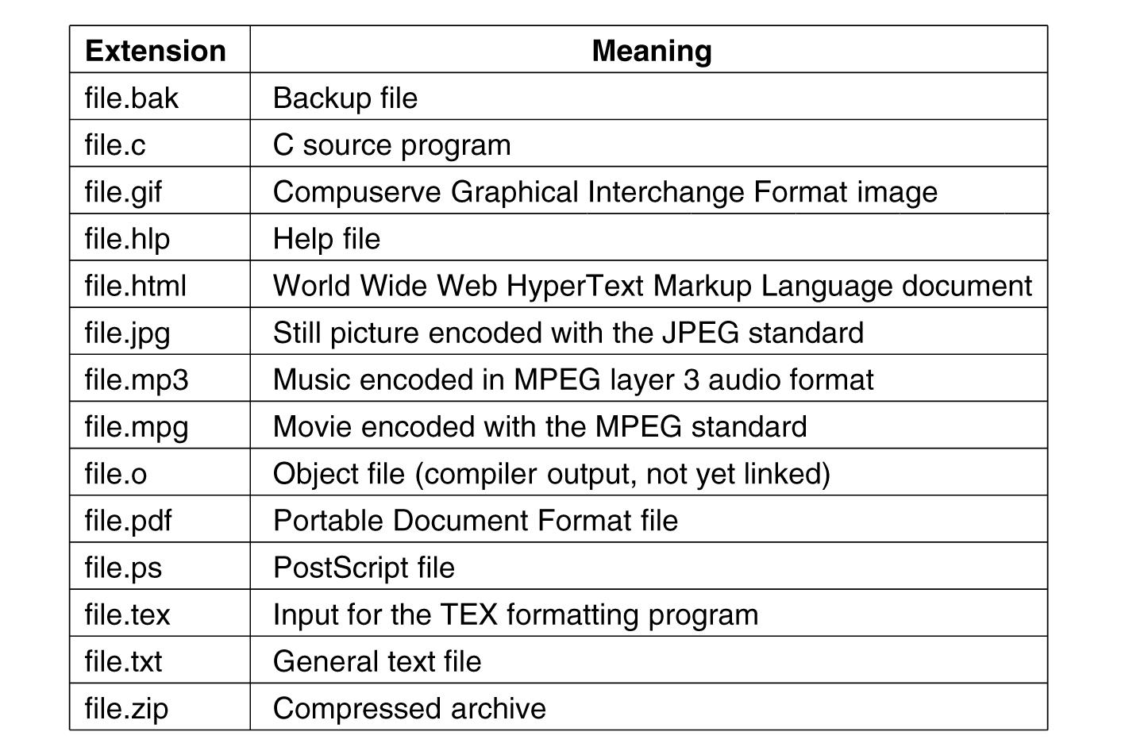
File Naming
Figure 4-1. Some typical file extensions.
cs431-cotter
Tanenbaum, Modern Operating Systems 3 e, (c) 2008 Prentice-Hall, Inc. All rights reserved. 0-13-6006639
Notes:
cs431-cottercs431-cotter

Slide 12
File Access Methods
Sequential Access
  Based on a magnetic tape model
  read next, write next
  reset
Direct Access
  Based on fixed length logical records
  read n, write n
  position to n
  relative or absolute block numbers
cs431-cotter
Notes:
cs431-cottercs431-cotter

Slide 13
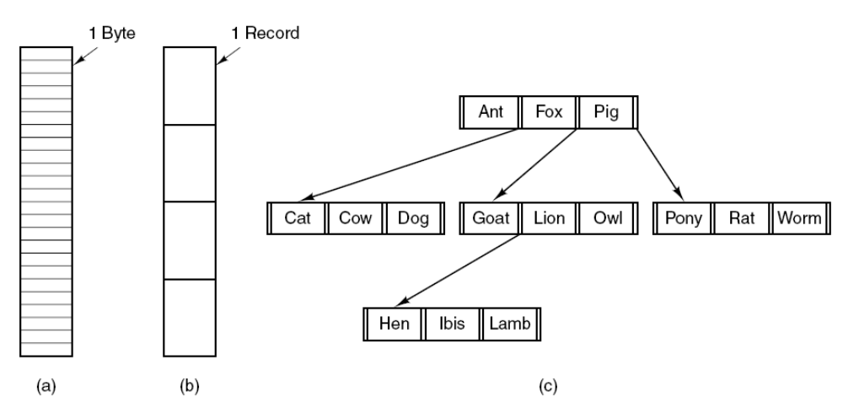
File Structure
Figure 4-2. Three kinds of files. (a) Byte sequence (Unix & windows). (b) Record sequence. (c) Tree (for mainframe computers for data processing)
Notes:
cs431-cottercs431-cotter

Slide 14
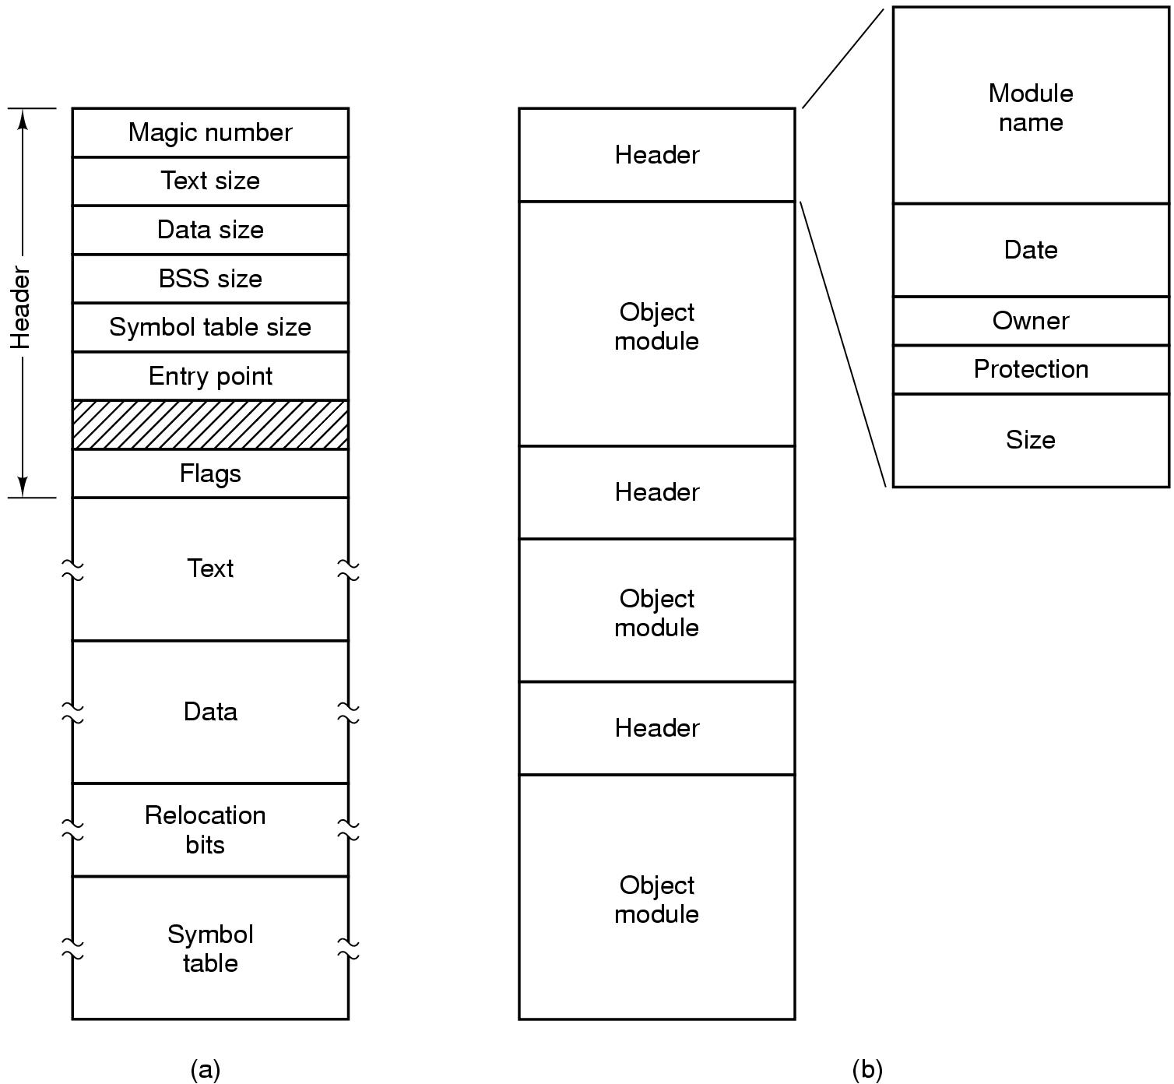
File Types
Figure 4-3. (a) An executable file. (b) An archive.
cs431-cotter
Tanenbaum, Modern Operating Systems 3 e, (c) 2008 Prentice-Hall, Inc. All rights reserved. 0-13-6006639
Notes:
cs431-cottercs431-cotter

Slide 15
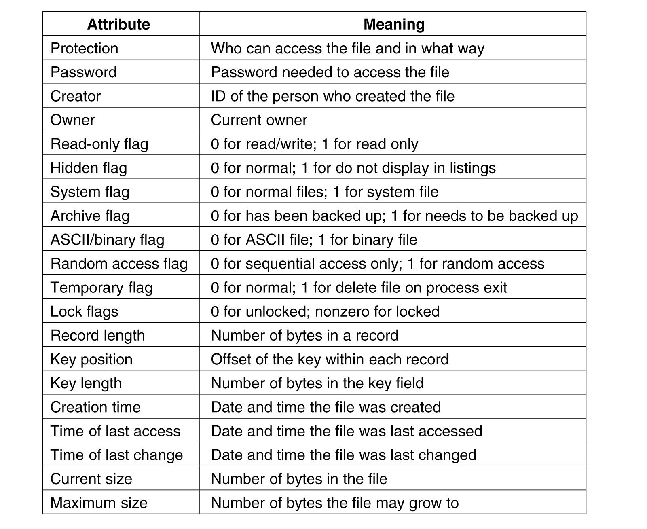
File Attributes
Figure 4-4a. Some possible file attributes.
cs431-cotter
Tanenbaum, Modern Operating Systems 3 e, (c) 2008 Prentice-Hall, Inc. All rights reserved. 0-13-6006639
Notes:
cs431-cottercs431-cotter

Slide 16
File Operations
The most common system calls relating to files:
Create
Delete
Open
Close
Read
Write
Append
Seek
Get Attributes
Set Attributes
Rename
cs431-cotter
Tanenbaum, Modern Operating Systems 3 e, (c) 2008 Prentice-Hall, Inc. All rights reserved. 0-13-6006639
Notes:
cs431-cottercs431-cotter

Slide 17
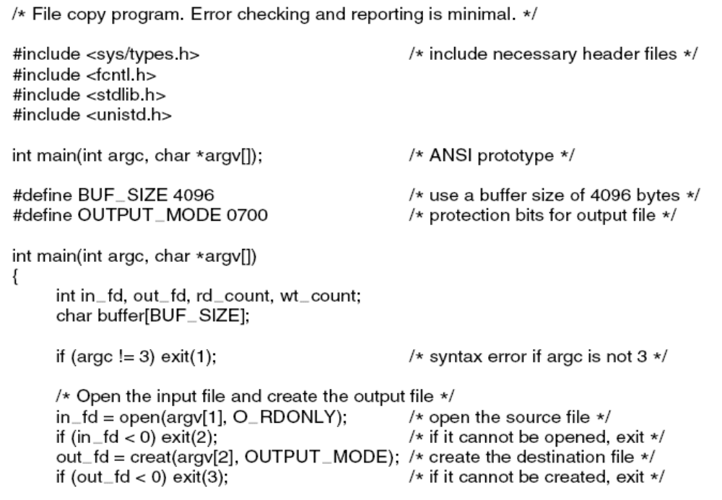
Example Program Using File System Calls (1)
. . .
Figure 4-5. A simple program to copy a file.
cs431-cotter
Tanenbaum, Modern Operating Systems 3 e, (c) 2008 Prentice-Hall, Inc. All rights reserved. 0-13-6006639
Notes:
cs431-cottercs431-cotter

Slide 18
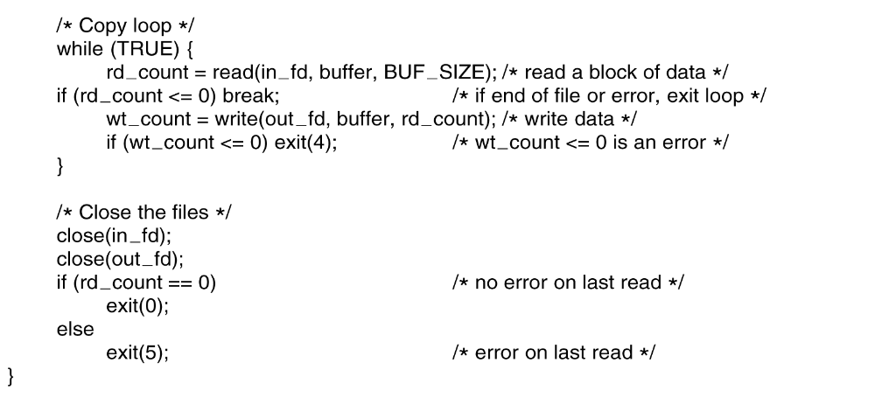
Example Program Using File System Calls (2)
Figure 4-5. A simple program to copy a file.
cs431-cotter
Tanenbaum, Modern Operating Systems 3 e, (c) 2008 Prentice-Hall, Inc. All rights reserved. 0-13-6006639
Notes:
cs431-cottercs431-cotter

Slide 19
Directory Structure
Collection of nodes containing information on all files
F4
F2
F3
F5
F1
cs431-cotter
Notes:
cs431-cottercs431-cotter

Slide 20
Information in a Device Directory
File name:
File Type:
Address:
Current Length
Maximum Length
Date Last accessed (for archiving)
Date Last updated (for dumping)
Owner ID
Protection information
cs431-cotter
Notes:
cs431-cottercs431-cotter

Slide 21
Directory Operations
Search for a file
Create a file
Delete a file
List a directory
Rename a file
Traverse the file system
cs431-cotter
Notes:
cs431-cottercs431-cotter

Slide 22
Alternative Directory Structures
Single-Level Directory
Issues:
  Naming
  Grouping
cat bo a test data mail cont hex word calc
cs431-cotter
Notes:
cs431-cottercs431-cotter

Slide 23
Alternative Directory Structures
Two-Level Directory
User1 User2 User3
cs431-cotter
Notes:
cs431-cottercs431-cotter

Slide 24
Tree-Structured Directory
cs431-cotter
Notes:
cs431-cottercs431-cotter

Slide 25
Allocation Methods
Contiguous Allocation
Each file occupies a set of contiguous blocks on the disk.
Number of blocks needed identified at file creation
  May be increased using file extensions
Advantages:
  Simple to implement
  Good for random access of data
Disadvantages
  Files cannot grow
  Wastes space
cs431-cotter
Notes:
cs431-cottercs431-cotter

Slide 26
Contiguous Allocation
FileA
File Allocation Table
FileA
0
1
2
3
4
File Name
Start Block
Length
5
6
7
8
9
FileA
2
3
FileB
FileB
9
5
10
11
12
13
14
FileC
18
8
FileD
30
2
15
16
17
18
19
FileE
26
3
FileC
20
21
22
23
24
FileE
25
26
27
28
29
FileD
30
31
32
33
34
cs431-cotter
Notes:
cs431-cottercs431-cotter

Slide 27
Allocation Methods
Linked Allocation
Each file consists of a linked list of disk blocks.
Advantages:
  Simple to use (only need a starting address)
  Good use of free space
Disadvantages:
  Random Access is difficult
data
ptr
data
ptr
data
ptr
data
Null
cs431-cotter
Notes:
cs431-cottercs431-cotter

Slide 28
Linked Allocation
FileB
File Allocation Table
0
1
2
3
4
File Name
Start Block
End
5
6
7
8
9
...
...
...
10
11
12
13
14
FileB
1
28
...
...
...
15
16
17
18
19
20
21
22
23
24
25
26
27
28
29
30
31
32
33
34
cs431-cotter
Notes:
cs431-cottercs431-cotter

Slide 29
Linked Allocation
FileB
File Allocation Table
0
1
2
3
4
File Name
Start Block
End
5
6
7
8
9
...
...
...
FileB
1
28
10
11
12
13
14
...
...
...
15
16
17
18
19
20
21
22
23
24
25
26
27
28
29
30
31
32
33
34
cs431-cotter
Notes:
cs431-cottercs431-cotter

Slide 30
Allocation Methods
Indexed Allocation
Collect all block pointers into an index block.
Advantages:
  Random Access is easy
  No external fragmentation
Disadvantages
  Overhead of index block
Index Table
cs431-cotter
Notes:
cs431-cottercs431-cotter

Slide 31
Indexed Allocation
File Allocation Table
0
1
2
3
4
File Name
Index Block
Jeep
24
5
6
7
8
9
10
11
12
13
14
15
16
17
18
19
20
21
22
23
24
1
3
25
26
27
28
29
8
14
30
31
32
33
34
28
cs431-cotter
Notes:
cs431-cottercs431-cotter

Slide 32
Indexed Allocation
File Allocation Table
0
1
2
3
4
File Name
Index Block
Jeep
24
5
6
7
8
9
10
11
12
13
14
15
16
17
18
19
20
21
22
23
24
1
8
25
26
27
28
29
3
14
30
31
32
33
34
28
cs431-cotter
Notes:
cs431-cottercs431-cotter

Slide 33
UNIX File System
File Types
Regular File
Directory
Block-oriented Device
Character-oriented Device
Symbolic Link
cs431-cotter
Notes:
cs431-cottercs431-cotter

Slide 34
UNIX File Ownership
read write execute
owner
1
1
0
group
1
0
0
others
1
0
0
(for directories: read, write, search)
-rwx------ 1 rsmith is 785 Feb 11 1994 send_exe
drwxr-xr-x 2 rsmith is 512 Apr 16 13:49 sysmon_server
cs431-cotter
Notes:
cs431-cottercs431-cotter

Slide 35
File Access Model
open -- read -- write -- close
fdesc = open (*filename, r / w / a / +);
n = read (fdesc, buff, 24);
n = write (fdesc, buff, 24);
lseek (fdesc, 100L, L_SET);
(L_SET, L_CUR, L_END)
close (fdesc);
cs431-cotter
Notes:
cs431-cottercs431-cotter

Slide 36
UNIX i-node
mode
owners(2)
timestamps(3)
data
size block
count
data
direct blocks
data
single indir
double indir
triple indir
cs431-cotter
Notes:
cs431-cottercs431-cotter

Slide 37
UNIX i-node
mode
owners(2)
timestamps(3)
data
size block
count
data
direct blocks
data
data
:
:
single indir
data
double indir
triple indir
cs431-cotter
Notes:
cs431-cottercs431-cotter

Slide 38
UNIX i-node
mode
owners(2)
timestamps(3)
data
size block
count
data
direct blocks
data
data
:
:
data
:
:
single indir
data
double indir
data
:
:
data
triple indir
:
:
data
cs431-cotter
Notes:
cs431-cottercs431-cotter

Slide 39
File system implementation
cs431-cotter

Slide 40
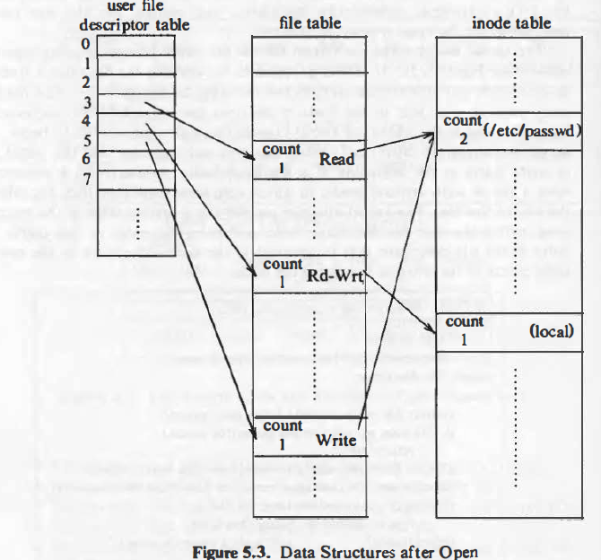
Data structures for open

Slide 41
Opening a UNIX File
fid = open(“fileA”, flags);
…
read(fid, buffer, len);
On-Device File Descriptor
0 stdin
1 stdout
2 stderr
3 ...
File structure
inode
User file descriptor table
Open File Table
In-core inode

Slide 42
Disk Drive Layout
(simplified)
Disk
Drive
partition
partition
partition
Partition
Block group
Block group
Block group
Block
Group
directory blocks and data blocks
I-list
I-node
I-node
I-node
I-node
cs431-cotter
Notes:
cs431-cottercs431-cotter

Slide 43
Sample filesystem:
Creating the directory “testdir”
directory
block
i-list
i-node
1267
i-node
2549
i-node
i-node
cs431-cotter
Notes:
cs431-cottercs431-cotter

Slide 44
Sample filesystem:
Creating the directory “testdir”
directory
block
i-list
i-node
1267
i-node
2549
i-node
i-node
1267
cs431-cotter
Notes:
cs431-cottercs431-cotter

Slide 45
Sample filesystem:
Creating the directory “testdir”
directory
block
i-list
i-node
1267
i-node
2549
i-node
i-node
1267
2549
testdir
cs431-cotter
Notes:
cs431-cottercs431-cotter

Slide 46
Sample filesystem:
Creating the directory “testdir”
directory
block
i-list
i-node
1267
i-node
2549
i-node
i-node
1267
2549
testdir
cs431-cotter
Notes:
cs431-cottercs431-cotter

Slide 47
Sample filesystem:
Creating the directory “testdir”
directory
block
directory
block
i-list
i-node
1267
i-node
2549
i-node
i-node
2549
1267
1267
2549
testdir
cs431-cotter
Notes:
cs431-cottercs431-cotter

Slide 48
Sample filesystem after creating the directory “testdir”
directory
block
directory
block
i-list
i-node
1267
i-node
2549
i-node
i-node
2549
1267
1267
2549
testdir
cs431-cotter
Notes:
cs431-cottercs431-cotter

Slide 49
Linux File System Structure
Linux uses a Virtual File System (VFS)
  Defines a file object
  Provides an interface to manipulate that object
Designed around OO principles
  File system object
  File object
  Inode object (index node)
Primary File System - ext2fs
  Supports (or maps) several other systems (MSDOS, NFS (network drives), VFAT (W95), HPFS (OS/2), etc.
cs431-cotter
Notes:
cs431-cottercs431-cotter

Slide 50
Virtual Filesystem
A kernel software layer that handles all system calls related to a standard UNIX filesystem.
Supports:
  Disk-based filesystems
    IDE Hard drives (UNIX, LINUX, SMB, etc.)
    SCSI Hard drives
    floppy drives
  Network filesystems
    remotely connected filesystems
  Special filesystems
    /proc
cs431-cotter
Notes:
cs431-cottercs431-cotter

Slide 51
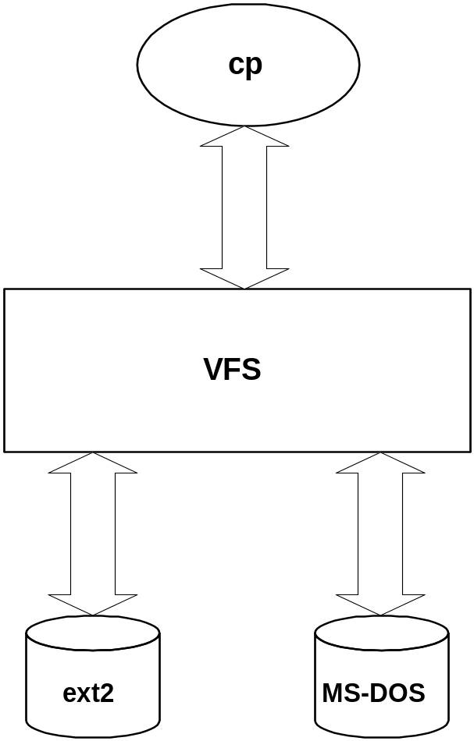
VF Example
inf = open (“/floppy/test”,
O_RDONLY, 0);
outf = open (“/tmp/test”, O_WRONLY|O_CREATE|O_TRUNC, 0600);
do {
cnt = read(inf, buf, 4096);
write (outf, buf, cnt);
} while (cnt);
close (outf);
close (inf);
cs431-cotter
Notes:
cs431-cottercs431-cotter

Slide 52
Virtual file system Model
Superblock object
  metadata about a mounted filesystem
inode object
  general information about a specific file
file object
  information about process and open file interaction
dentry object
  directory entry information
cs431-cotter
Notes:
cs431-cottercs431-cotter

Slide 53
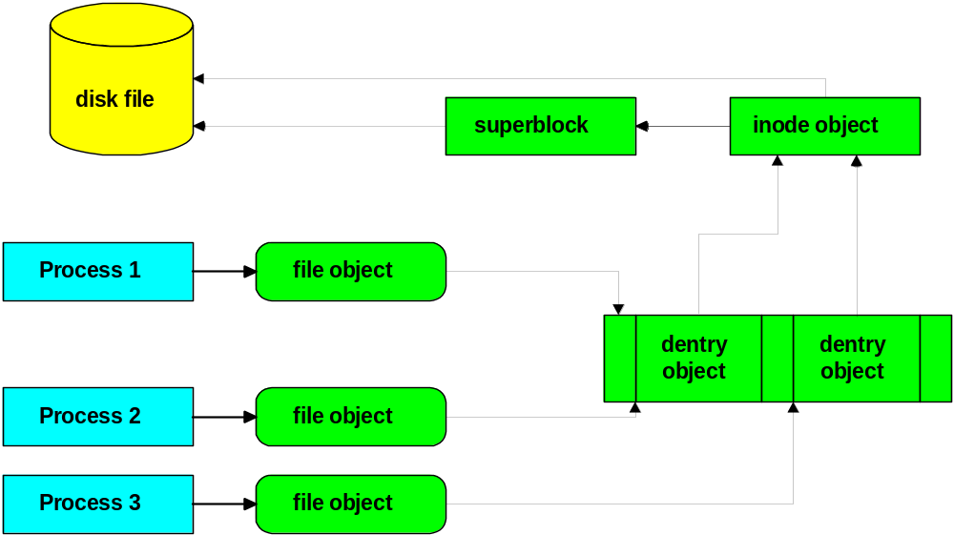
Virtual Filesystem and Processes
cs431-cotter
Notes:
cs431-cottercs431-cotter

Slide 54
Ext2fs History
Minux
extfs
ext2fs - 1994
cs431-cotter
Notes:
cs431-cottercs431-cotter

Slide 55
Ext2fs Blocks
1k default
2k, 4k possible
choice based on file sizes
cs431-cotter
Notes:
cs431-cottercs431-cotter

Slide 56
Ext2fs Disk Data Structures
Boot
Block
Block Group 0
Block Group N
Super
Block
Group
Descriptors
Data block
Bitmap
Inode
Bitmap
Inode
Table
Data Blocks
Each Block Group contains:
  A copy of the Super Block
  A copy of the group of block group descriptors
  A data block bitmap (for this group)
  An inode bitmap (for this group)
  A group of inodes (for this group)
  Data blocks
cs431-cotter
Notes:
cs431-cottercs431-cotter

Slide 57
Disk Data Structures
SuperBlock
  Contains metadata about the block group
  # free blocks,
  # free inodes,
  block size,
  times (last mount, last write),
  check status,
  blocks to pre-allocate,
  alignments, etc. (~38 items)
cs431-cotter

Slide 58
Disk Data Structures
Block Groups
  Block group limited to 8 * block size by data block bitmap.
  1k block limited to 8,192 blocks or 8 mbytes per block group. 4k block = 128 mbytes
Group descriptor - 24 bytes per group
  block numbers for bitmaps, start of tables, etc.
cs431-cotter
Notes:
cs431-cottercs431-cotter

Slide 59
Disk Data Structures
Inode Table
  Inodes - 128 bytes
  File type and access rights
  owner
  length
  timestamps (last access, last change, etc.)
  hard links counter
  pointers to data blocks,
  etc.
cs431-cotter
Notes:
cs431-cottercs431-cotter

Slide 60
Disk Data Structures
Items cached in memory on filesystem mount
  Superblock - always cached
  Group descriptor - always cached
  Block bitmap - fixed limit - most recent only
  Inode bitmap - fixed limit - most recent only
  Inode - dynamic
  Data block - dynamic
cs431-cotter
Notes:
cs431-cottercs431-cotter

Slide 61
Summary Features
Fast Symbolic Links
pre-allocation of data blocks
file-updating strategy
immutable files or append only files
cs431-cotter
Notes:
cs431-cottercs431-cotter

Slide 62
Journal File Systems
Designed to speed file system recovery from system crashes.
Traditional systems use an fs recovery tool (e.g. fsck) to verify system integrity
As file system grows, recovery time grows.
Journal File Systems track changes in meta-data to allow rapid recovery from crashes
cs431-cotter
Notes:
cs431-cottercs431-cotter

Slide 63
Journal File System
Uses a version of a transaction log to track changes to file system directory records.
If a system crash occurs, the transaction log can be reviewed back to a check point to verify any pending work (either undo or redo).
For large systems, recovery time goes from hours or days to seconds.
cs431-cotter
Notes:
cs431-cottercs431-cotter

Slide 64
Journal File System - Examples
XFS
  Commercial port by SGI (IRIX OS)
  Based on 64 bit system (ported to 32 bit)
  Supports large systems 2TB -> 9 million TB
  Uses B+trees for improved performance
  Journals file system meta-data
  Supports Quotas, ACLs.
  Supports filesystem extents (contiguous blocks)
cs431-cotter
Notes:
cs431-cottercs431-cotter

Slide 65
Journal File System - Examples
JFS
  Commercial Port by IBM. Used in OS/2
  64 bit system ported to 32 bits.
  Journal support of meta-data.
  System Size 2TB -> 32PB
  Built to scale on SMP architectures
  Uses B+trees for improved performance
  Supports use of extents.
cs431-cotter
Notes:
cs431-cottercs431-cotter

Slide 66
Journal File System - Examples
ReiserFS
  Designed originally for Linux (32 bit system)
  Supports file systems to 2TB -> 16TB
  Journal support of meta-data
  Btree structure supports large file counts
  Supports block packing for small files
  No fixed inode allocation - more flexible.
cs431-cotter
Notes:
cs431-cottercs431-cotter

Slide 67
Journal File System - Examples
Ext3fs
  Simple extension of ext2fs that adds journaling
  All virtual file system operations are journaled.
  Other limitations of ext2fs remain.
cs431-cotter
Notes:
cs431-cottercs431-cotter

Slide 68
Journal File System - Examples
ext4fs
  Next generation of file system development, incorporating improvements and changes to ext3fs.
  Journalling filesystem
    Improvements is journal checksumming
  Larger file systems – 1 MTB (exabyte)
    Larger files – 16 TB
  Delayed block allocation, multi-block allocator
    Allows files to be written as contiguous sequences of blocks: improves read performance of streaming data files.
    Poses the risk of lost data if system crashes before data is written.
  Use of extents
    Large (<= 128 MB) contiguous physical blocks.
cs431-cotter
Notes:
cs431-cottercs431-cotter

Slide 69
Free Space Management
Bit Vector management
One bit for each block
  0 = free; 1 = occupied
Use bit manipulation commands to find free block
Bit vector requires space
  block size = 4096 = 2 ¹²
  disk size = 1 gigabyte = 2 ³⁰
  bits = 2 ⁽³⁰⁻¹²⁾ = 2 ¹⁸ = 32k bytes
0
1
1
0
.....
1
cs431-cotter
Notes:
cs431-cottercs431-cotter

Slide 70
Free Space Management
Bit vector (advantages):
  Easy to find contiguous blocks
Bit vector (disadvantages):
  Wastes space (bits allocated to unavailable blocks)
Issues:
  Must keep bit vector on disk (reliability)
  Must keep bit vector in memory (speed)
  cannot allow memory != disk (memory = 1, disk = 0)
cs431-cotter
Notes:
cs431-cottercs431-cotter

Slide 71
Free Space Management
Grouping of blocks
Boot
block
File
system
descriptor
File
descriptors
cs431-cotter
Notes:
cs431-cottercs431-cotter

Slide 72

Reducing Disk Arm Motion
Figure 4-29. (a) I-nodes placed at the start of the disk.
(b) Disk divided into cylinder groups, each with its own blocks and i-nodes.
cs431-cotter
Tanenbaum, Modern Operating Systems 3 e, (c) 2008 Prentice-Hall, Inc. All rights reserved. 0-13-6006639
Notes:
cs431-cottercs431-cotter

Slide 73
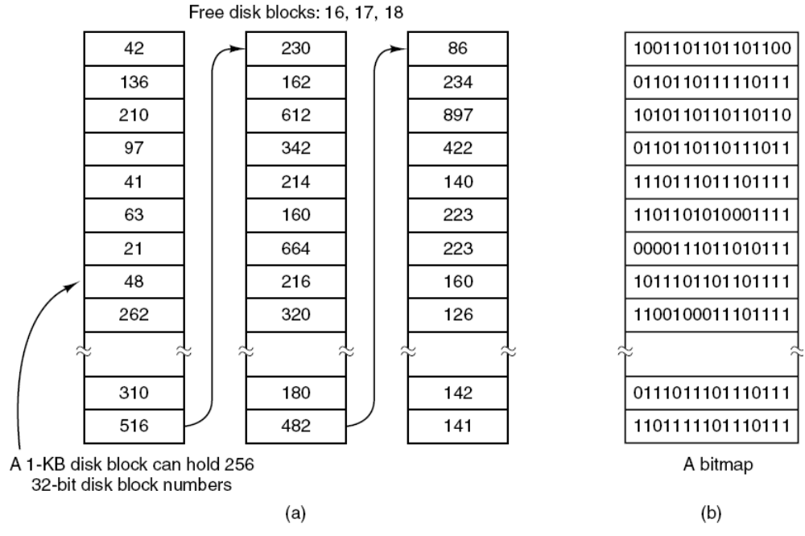
Keeping Track of Free Blocks (1)
Figure 4-22. (a) Storing the free list on a linked list. (b) A bitmap.
cs431-cotter
Tanenbaum, Modern Operating Systems 3 e, (c) 2008 Prentice-Hall, Inc. All rights reserved. 0-13-6006639
Notes:
cs431-cottercs431-cotter

Slide 74
Summary
File Structures
Directory Structures
File System Implementation
File System Management
Example File Systems
cs431-cotter

